Slide 1
Network Dynamics: How Can We Find Patients Like Us?
Lu YAN, Jianping PENG, Yong TAN
2015, Information Systems Research

Slide 2

Know the authors

Slide 3
Yong TAN
“Online Cash-back Shopping: Implications for Consumers and e-Businesses,” with Y.-C. Ho and Y.-J. Ho, Information Systems Research 28(2) 250-264, 2017.
“Influentials, Imitables or Susceptibles? Virality and Word of Mouth Conversations in Online Social Networks,” with A. Susarla and C. Oh, Journal of Management Information Systems 33(1) 139-170, 2016.
“Do I Follow My Friends or the Crowd? Informational Cascades in Online Movie Ratings,” with Y.J. Lee and K. Hosanagar, Management Science, 61(9) 2241-2258, 2015.
“Feeling Blue? Go Online: An Empirical Study of Online Supports among Patients,” with L. Yan, Information Systems Research, 25(4) 690-709, 2014.
“Network Effects: The Influence of Social Capital on Open Source Project Success,” with P.V. Singh and V.S. Mookerjee, Management Information Systems Quarterly, 35(4) 813-829, 2011.

Slide 4
Introduction
The utilization of social media in healthcare is growing
  Patients as information contributors and consumers
  Receive help from resources without geographical barriers
Most conceptual and empirical attention has concentrated on the effects of social support. However, comprehending social networks’ effects on health requires not only an understanding of how networks are functioning but also how they are formed
  The formation of social ties between patients, further, the motivational foundation for patients’ social networking behavior and the cognitive aspect of social networking

Slide 5
Introduction
Two plausible mechanisms>>>
Homophily: Research has shown that strategic selection behavior is a result of homophily (i.e., a preference for similarity), a concept that social scientists have identified as one of the important mechanisms for why people create, maintain, dissolve, and reconstitute communication networks (Monge and Contractor 2003).
  Similarities in #disease, #symptoms, #drugs, and #treatments
Cognitive capabilities: Despite the obvious benefits of communicating with more patients who suffer from similar health conditions, social interactions involve the strain of dealing with other individuals as well as the time and effort to contribute their own experiences and draw from the collective knowledge (Jones et al. 2004, Wasko and Faraj 2005).

Slide 6
Conceptual background & hypothesis
Social Capital
  Social capital resources are embedded in a social structure and in the relationships between individuals and their connections within communities (Putnam 1995).
Personal resources, provided by shared health experiences, and social resources, provided by online connections (Lin 2001).
Egocentric network
alter
ego
1-step egocentric network

Slide 7
Conceptual background & hypothesis
Hypothesis 1 (H1). The more experientially similar a patient (alter) is compared to the focal patient (ego), the more likely that the ego will form a social connection
  Homophily, social comparison theory
  #age, #gender, #state, #disease, #symptom, #drug experience, #treatment experience
Hypothesis 2A (H2A). A patient’s network expansion has a curvilinear (inverted-U) relationship with network size.
  Cognitive limits
  #network size, #network size2
Hypothesis 2B (H2B). The more experiential information that a patient needs to process, the less likely that she will establish new social connections.
  Information-processing: we expect that it is less likely for a patient to go beyond her current social relations for social support when she has more health conditions to take into consideration.
  #info.load: The total number of prescription drugs and treatments a patient takes

Slide 8
Conceptual background & hypothesis
Hypothesis 3 (H3). The more embedded a patient is in the network, the less likely that she will establish new social relations.
  Social “position”
  #network embeddedness
  Betweenness centrality (key node for information dissemination, shortest paths between other node-pairs pass through this node)
B
A
E
F
C
D

Slide 9
Conceptual background & hypothesis
Hypothesis 4 (H4). The probability of establishing new social relations decreases with a patient’s cost to explore the network.
  Search cost; mismatch problem
  #network cost: the shortest path between two patients
  #search cost: the alter’s posting activities (easy to be searched)

Slide 10
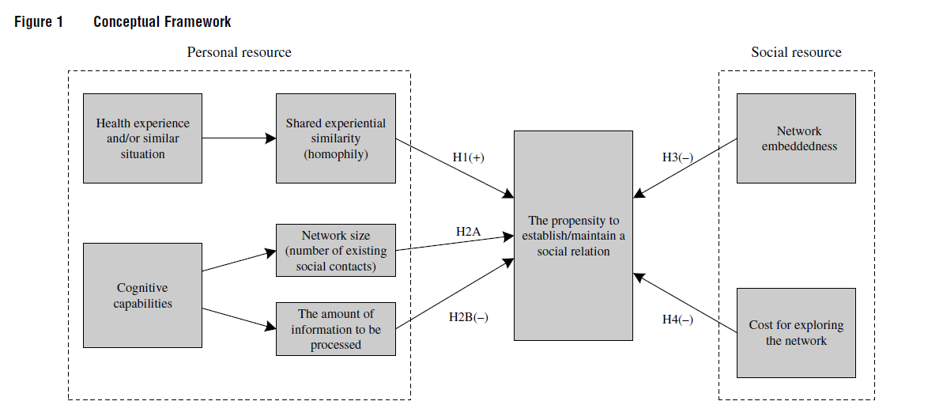

Slide 11
Dataset
Starting in late 2009 for 4 months, from a community focus on mental problems (social disease, needs more social support)
Subscription network
1322 patients, 3 time stamps
B
A
O
C
Patient

Slide 12
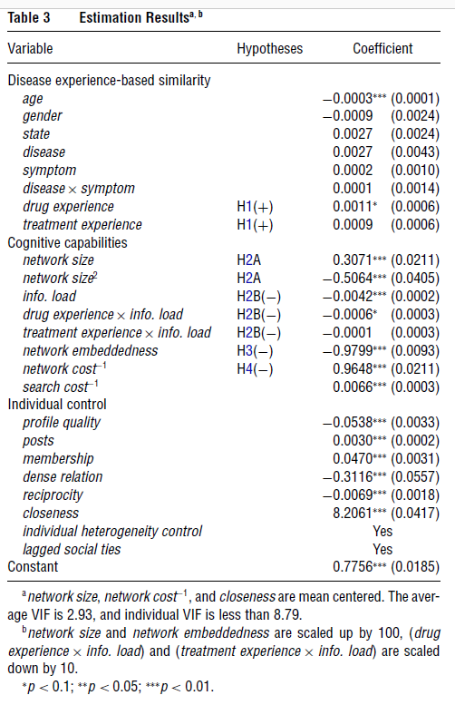
Empirical results
Why interaction effect?
The effect of IV I on DV depends on the value of IV II.
Disease: 1 if diagnosed with same disease
Symptom: the number of same symptoms two patients suffer
Help to see whether further categorization (Disease=0, or 1) has significant effect
Control variables

Slide 13
Robustness checks
Whether the coefficients are significant after removing or adding more regressors
Other network controls
  Transitivity: the ratio of the number of transitive triads in the existing network over the number of possible transitive triads. → another measure of closeness
  Structural equivalence: two actors are structurally equivalent if they have the same types of ties to the same (types of) people. → dissimilarity index, another measure of dense relation
After controlling these effect, did not lead to statistically significantly different results.

Slide 14
Results
Our work focuses on the communication network structure and the driving factors behind its configuration dynamics.
  Patients’ (disease) experience-based similarity
  Cognitive capabilities
Our results indicate that patients are unlikely to form close connections (or cohesive groups) in online healthcare communities, as shown by the significant but negative coefficient for dense relation.

Slide 15
Implications to our research
Modeling network dynamics
  Academic collaboration network

Slide 16
Appendix: Random effect model & Network analysis

Slide 17




Fixed Effects Model
Panel data: 对固定样本的重复观测
(Entity) Fixed effects model: regression analysis of panel data (eliminate the effect of omitted variables that differ across entities but constant over time)
  An extension of multiple regression that exploits panel data to control for variables that differ across entities but constant over time
Time fixed effects
  Control for variables that are constant across entities but evolve over time
Entity fixed effects
Linear regression:
$Y_{i}$=$β_{0}+β_{1}X_{i}{+u}_{i}$
Entity: Nations (China, US, etc)
Time: 2012, 2013, 2014
Unobserved variable: Culture
Unobserved variables:
$Y_{it}$=$β_{0}+β_{1}X_{it}{+β_{2}Z_{i}+u}_{it}$
Fixed effects model:
$Y_{it}$=$β_{1}X_{it}{+α_{i}+u}_{it}$
Time fixed effects
Entity: Nations (China, US, etc)
Time: 2012, 2013, 2014
Unobserved variable: Safety improvements in new cars
$α_{i}$: entity fixed effects, vary across entities but constant over time
Time effects model:
$Y_{it}$=$β_{1}X_{it}{+γ_{t}+u}_{it}$
Extension: both entity and time fixed effects

Slide 18
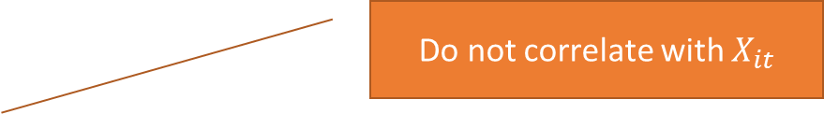


Random effects model
A special case of Fixed Effects Model
Do not correlate with $X_{it}$
$Y_{it}$=$β_{1}X_{it}{+α_{i}+u}_{it}$
随机效应
Y: 健康状况
：饮食状况；体重
Random Effects: 出生那天空气质量
$$X_{it}$$
When to use Random Effects Model?
random effects很少用，它的假设太苛刻了，面板的精髓就在于固定效应
在选择random effects vs fixed effects之前，一般先做一个hausman test, hausman test原假设是未观测的变量和解释变量无关（也就是固定效应和随机效应估计结果相同），如果拒绝了原假设，就要用固定效应
但是很多文献都不care这个检验，很多人提倡：你认为该用什么，就用什么，拿不准的时候一律用fixed effects

Slide 19
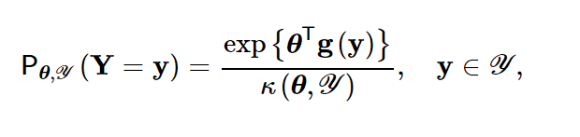
Exponential Random Graph Model
指数随机图模型
ERGM: used to model “snap-shots” of relational networks in sociology for statistical network analysis
R package: https://www.ncbi.nlm.nih.gov/pmc/articles/PMC2743438/
Network modeling: adjacency matrix y
参数化
Normalizing factor, consider all possible random graphs

Slide 20
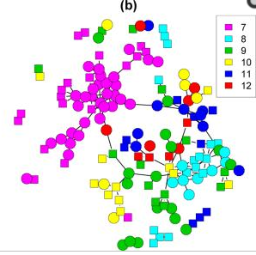
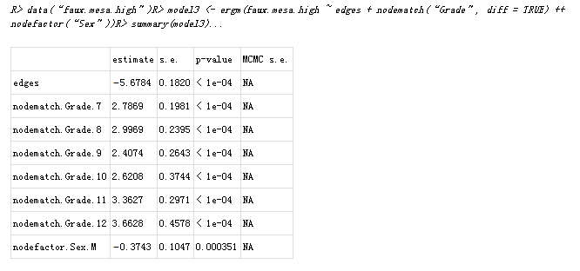
Exogenous covariates and dyadic independence
Replace g(y) by g(y, X), where X is an n*n*p array
  n nodes; p attributes for node-pair
X → y
Two students in the same grade → form a friendship tie
Two students with at least one as male→ negatively form a friendship tie

Slide 21
Centrality measures
度中心性 (Degree centrality ) e.g., C
  拥有连接数
特征向量中心性 (Eigenvector centrality ) e.g., E
  与重要节点相连，高影响力
中介中心性 (Betweenness centrality) e.g., C
  信息传播重要节点
A
B
C
D
E
F
G

Slide 22
Other descriptive metrics
集聚系数（Clustering coefficient,节点指标/网络指标 ）
  点：邻居的链接程度
  网：网络成员的紧密联系程度
  用于社区发现；小世界网络
密度（Density，网络指标 ）
  现有连接数/所有可能连接数，衡量网络内链接稀疏度
  完全网络(=1)；非完全网络(<1)
A
B
C
D
E
F
G

